Slide 1
Major Histocompatibility Complex
Dr Mohammed Shoeb
Assistant Professor
Department of Zoology
Govt. Dr WW Patankar Girl’s PG College, Durg

Slide 2
Introduction
Mammals possess a tightly linked cluster of genes, the major histocompatibility complex (MHC), whose products play roles in intercellular recognition and in discrimination between self and nonself.
The MHC participates in the development of both Humoral and Cell mediated immune responses.

Slide 3
MHC molecules act as antigen-presenting structures, T cells recognize antigen only when it is combined with an MHC molecule.
Peter Gorer and George Snell identified “histocompatibility genes” during their work on blood-group antigens.

Slide 4
The MHC Encodes Three Major Classes of Molecules
The major histocompatibility complex is a collection of genes arrayed within a long continuous stretch of DNA on chromosome 6 in humans and on chromosome 17 in mice
The MHC genes are organized into regions encoding three classes of molecule:
Class I MHC genes encode glycoproteins expressed on the surface of nearly all nucleated cells; the major function of the class I gene products is presentation of peptide antigens to TC cells.

Slide 5
Class II MHC genes encode glycoproteins expressed primarily on antigen-presenting cells (macrophages, dendritic cells, and B cells), where they present processed antigenic peptides to TH cells.
Class III MHC genes encode, in addition to other products, various secreted proteins that have immune functions, including components of the complement system and molecules involved in inflammation.

Slide 6
The class I and class II MHC molecules have common structural features and both have roles in antigen processing.
By contrast, the class III MHC region, which is flanked by the class I and II regions, encodes molecules that are critical to immune function but have little in common with class I or II molecules.
Class III products include the complement components C4, C2, BF and inflammatory cytokines, including tumor necrosis factor (TNF) and heat-shock proteins.

Slide 7
Structure of MHC Class-I Molecule
Class I Molecules Have a Glycoprotein Heavy Chain and a Small Protein Light Chain.
Class I MHC molecules contain a 45-kilodalton (kDa) α chain associated non-covalently with a 12-kDa β2-microglobulin molecule.
The α chain is a transmembrane glycoprotein encoded by polymorphic genes.
β2-microglobulin is a protein encoded by a highly conserved gene located on a different chromosome.

Slide 8
α chain of class I MHC molecules is organized into three external domains (α 1, α 2, and α 3), each containing approximately 90 amino acids
A transmembrane domain of about 25 hydrophobic amino acids followed by a short stretch of charged (hydrophilic) amino acids
A cytoplasmic anchor segment of 30 amino acids. The β2-microglobulin is similar in size and organization to the α3 domain; it does not contain a transmembrane region and is non covalently bound to the class I glycoprotein.

Slide 9
The peptide-binding cleft is located on the top surface of the class I MHC molecule, and it is large enough to bind a peptide of 8–10 amino acids.

Slide 10
Structure of MHC Class-II Molecule
Class II Molecules Have Two Nonidentical Glycoprotein Chains.
Class II MHC molecules contain two different polypeptide chains, a 33-kDa α-chain and a 28-kDa β-chain, which associate by non-covalent interactions.
Like class I α chains, class II MHC molecules are membrane-bound glycoproteins that contain external domains, a transmembrane segment, and a cytoplasmic anchor segment.

Slide 11
Each chain in a class II molecule contains two external domains: α 1 and α2 domains in one chain and β1 and β2 domains in the other.
The membrane-proximal are α2 and β2 domains.
The membrane-distal portion is composed of the α1 and β1 domains and forms the antigen binding cleft for processed antigen.

Slide 12
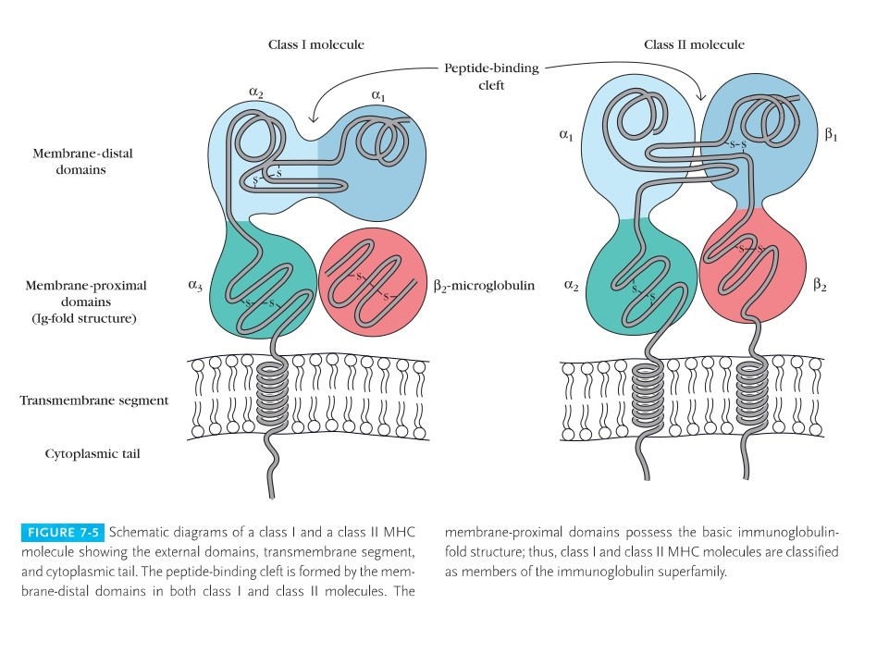

Slide 13
Peptide binding by class I and class II MHC molecule
 | Class I molecules | Class I molecules
Peptide-binding domain | α1/α2 | α1/β1
Nature of peptide-binding cleft | Closed at both ends | OPEN at both ends
General size of bound peptides | 8–10 amino acids | 13–18 amino acids
Peptide Motifs involved in binding to MHC | Anchor residues at both ends of Peptide, Generally Hydrophobic at C terminal | Anchor residues distributed along the length of the peptide

Slide 14
The peptide–MHC molecule association is very stable (Kd ~ 106 ) under physiologic conditions; thus, most of the MHC molecules expressed on the membrane of a cell will be associated with a peptide of self or nonself origin.

Slide 15
CLASS I MHC–PEPTIDE INTERACTION
Class I MHC molecules bind peptides and present them to CD8+ T cells.
In general, these peptides are derived from endogenous intracellular proteins that are digested in the cytosol.
Because a single nucleated cell expresses about 105 copies of each class I molecule, many different peptides will be expressed simultaneously on the surface of a nucleated cell by class I MHC molecules.

Slide 16
CLASS II MHC–PEPTIDE INTERACTION
Class II MHC molecules bind peptides and present these peptides to CD4+ T cells.
Like class I molecules, molecules of class II can bind a variety of peptides.
In general, these peptides are derived from exogenous proteins (either self or nonself), which are degraded within the endocytic processing pathway.

Slide 17
MHC Diversity
Class I and Class II Molecules Exhibit Diversity Within a Species and Multiple Forms Occur in an Individual.
The MHC possesses an extraordinarily large number of different alleles at each locus and is one of the most polymorphic genetic complexes known in higher vertebrates
This enormous polymorphism results in a tremendous diversity of MHC molecules within a species.

Slide 18
MHC Expression
Class I molecules are expressed on most nucleated cells; class II antigens are restricted to B cells, macrophages, and dendritic cells.
The class III region of the MHC encodes molecules that include a diverse group of proteins that play no role in antigen presentation.

Slide 19
Reference
Immunology by Kuby

